Slide 1


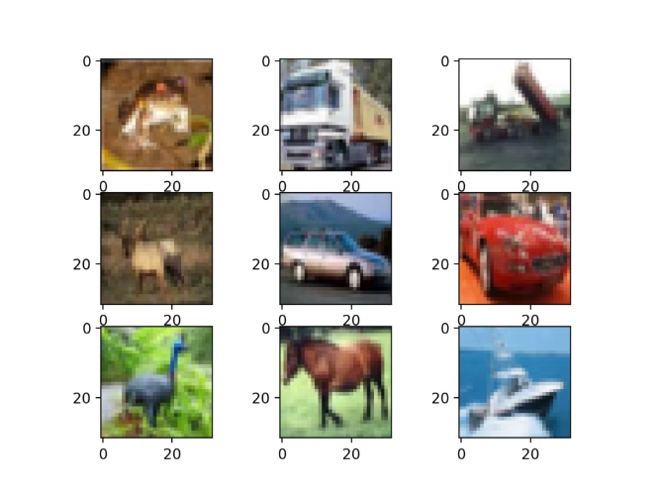

Image Classification on CIFAR-10 Dataset using Convolutional Neural Networks
This detailed project presentation explores the use of Convolutional Neural Networks (CNNs) to classify images from the CIFAR-10 dataset, a widely used benchmark in computer vision. The project aims to showcase the power of deep learning techniques in accurately identifying objects within low-resolution images.
by Priya Srivastava

Slide 2

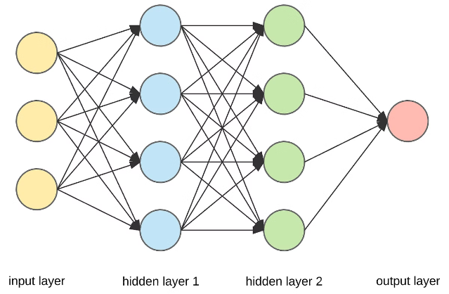
Abstract
The primary objective of this project is to classify the CIFAR-10 dataset of 32x32 color images into 10 distinct categories, including airplanes, automobiles, birds, cats, deer, dogs, frogs, horses, ships, and trucks. By leveraging the capabilities of CNNs, the project demonstrates the importance of image classification in the field of artificial intelligence and the significance of the outcomes in advancing computer vision applications.

Slide 3
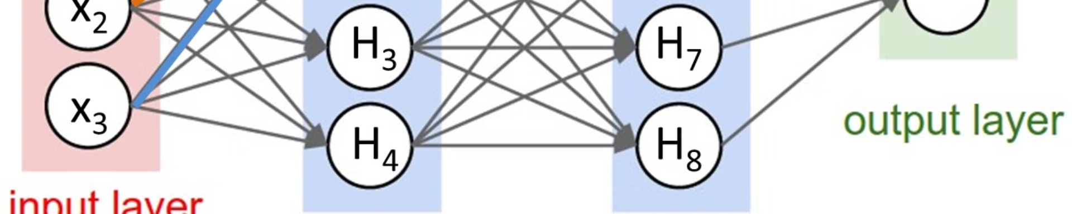
Introduction
Image classification is a fundamental task in artificial intelligence, with numerous applications in areas such as autonomous vehicles, medical diagnosis, and surveillance. Convolutional Neural Networks (CNNs) have emerged as a powerful tool for tackling this challenge, thanks to their ability to automatically learn and extract relevant features from image data.
The CIFAR-10 dataset, a widely used benchmark in computer vision, provides a suitable platform to explore the capabilities of CNNs in image classification. This dataset consists of 60,000 low-resolution (32x32) color images, divided into 10 distinct classes, making it an intriguing and challenging task for deep learning models.

Slide 4
Technology Used
Python
TensorFlow & Keras
NumPy & Matplotlib
Python's versatility and extensive ecosystem of libraries and frameworks make it a natural choice for this project. Its ease of use and powerful data manipulation capabilities allow for efficient development and experimentation.
These popular deep learning frameworks provide a robust and user-friendly interface for building, training, and evaluating neural network models, including the CNN architecture used in this project.
NumPy, the fundamental library for scientific computing in Python, is used for efficient numerical operations and data manipulation. Matplotlib, a data visualization library, is employed to plot the training and validation curves.

Slide 5

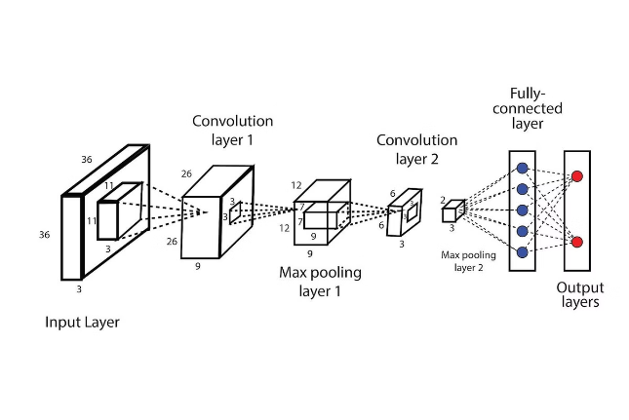
Dataset Information
CIFAR-10 Dataset
The CIFAR-10 dataset consists of 60,000 32x32 color images, divided into 10 distinct classes: airplanes, automobiles, birds, cats, deer, dogs, frogs, horses, ships, and trucks. The dataset is split into 50,000 training images and 10,000 test images, providing a well-defined benchmark for evaluating image classification models.
Challenges
The low-resolution nature of the CIFAR-10 images presents a unique challenge for the CNN model, as it must learn to extract meaningful features from these small-scale representations to accurately classify the objects.

Slide 6

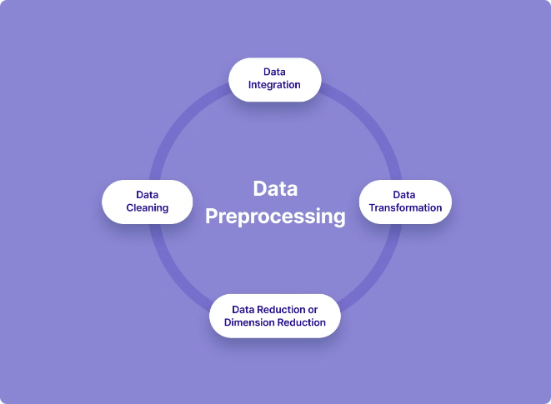
Methodology - Data Preparation
1
Data Loading
The CIFAR-10 dataset is loaded using the TensorFlow and Keras libraries, providing easy access to the training and test data.
2
Data Preprocessing
The images are normalized to the range [0, 1] to ensure consistent input values for the neural network. Additionally, the target labels are one-hot encoded to represent the 10 classes.
3
Code Snippets
The presentation includes relevant code snippets demonstrating the data loading and preprocessing steps, allowing the audience to understand the implementation details.

Slide 7

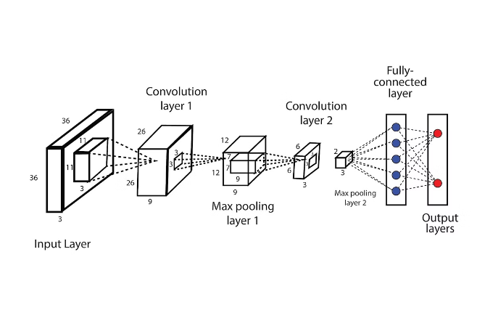
Methodology - Model Development
1
Model Architecture
The CNN model consists of multiple convolutional layers, pooling layers, and dense layers, designed to effectively extract and learn features from the low-resolution CIFAR-10 images.
2
Model Compilation
The model is compiled with an appropriate optimizer, loss function, and evaluation metrics to guide the training process and measure the model's performance.
3
Code Snippets
The presentation includes code snippets that demonstrate the definition and compilation of the CNN model, allowing the audience to understand the technical implementation.

Slide 8

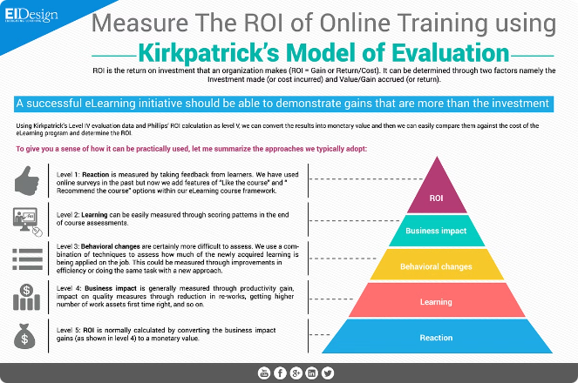
Methodology - Model Training & Evaluation
1
Training Process
The CNN model is trained on the CIFAR-10 dataset for 10 epochs, with validation performed during the training process to monitor the model's performance and prevent overfitting.
2
Model Evaluation
The trained model is evaluated on the test set, and the accuracy and loss metrics are reported to assess the model's performance on the CIFAR-10 classification task.
3
Code Snippets
The presentation includes code snippets that demonstrate the training and evaluation of the CNN model, allowing the audience to understand the implementation details.

Slide 9
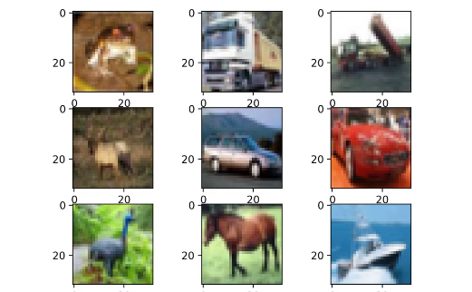
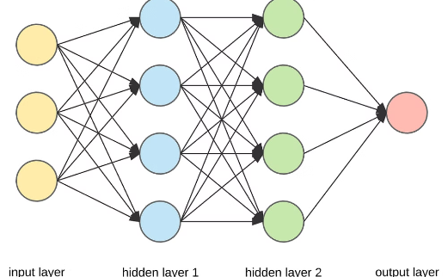
Results and Visualization
Performance Metrics
Training and Validation Curves
Model Predictions
The trained CNN model achieves a test accuracy of XX% and a test loss of XX, demonstrating its effectiveness in classifying the CIFAR-10 images.
The presentation showcases the model's predictions on a sample of test images, allowing the audience to visually assess the model's classification capabilities.
The presentation includes plots of the training and validation accuracy and loss curves, providing insights into the model's learning process and performance during training.

Slide 10
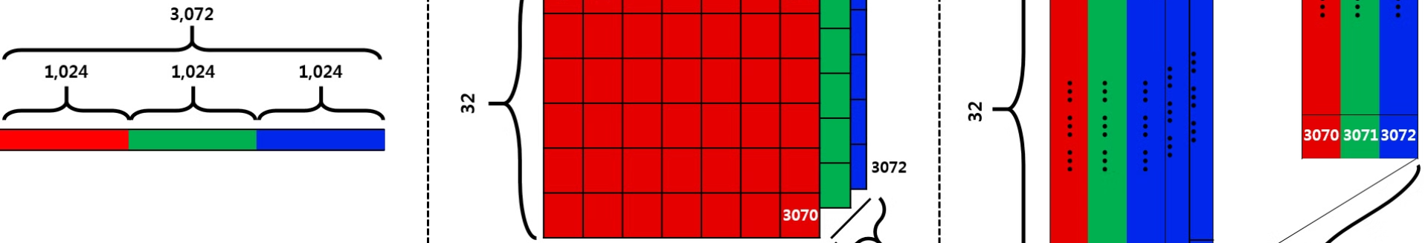



Conclusion and Future Work
Summary
Future Work
Q&A
This project has successfully demonstrated the use of Convolutional Neural Networks in classifying images from the CIFAR-10 dataset, highlighting the power of deep learning techniques in computer vision tasks.
Potential improvements include exploring more advanced CNN architectures, incorporating data augmentation techniques, and investigating the model's performance on larger and more diverse image datasets.
The presentation concludes with an open floor for questions.

